Slide 1
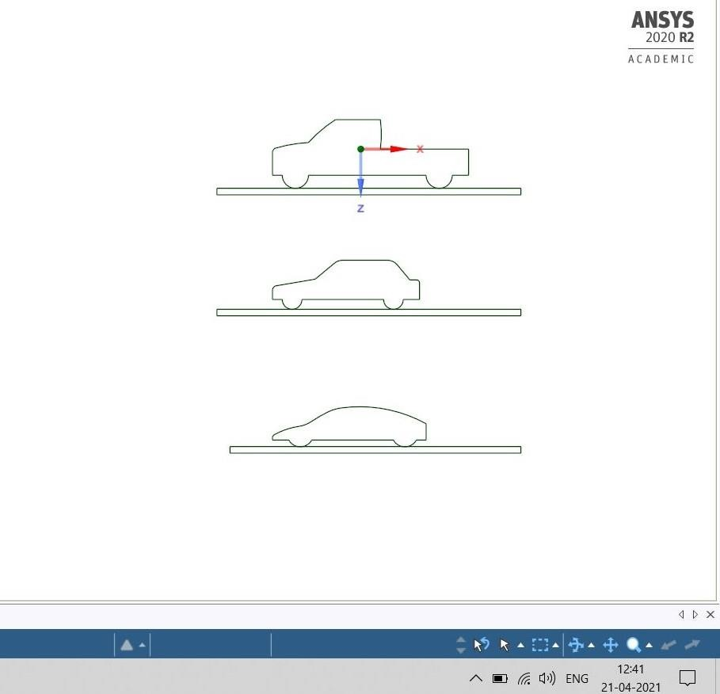
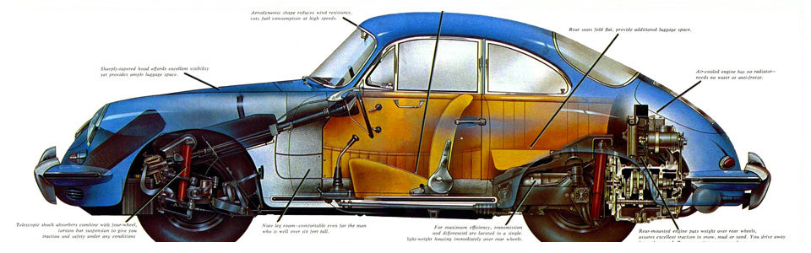
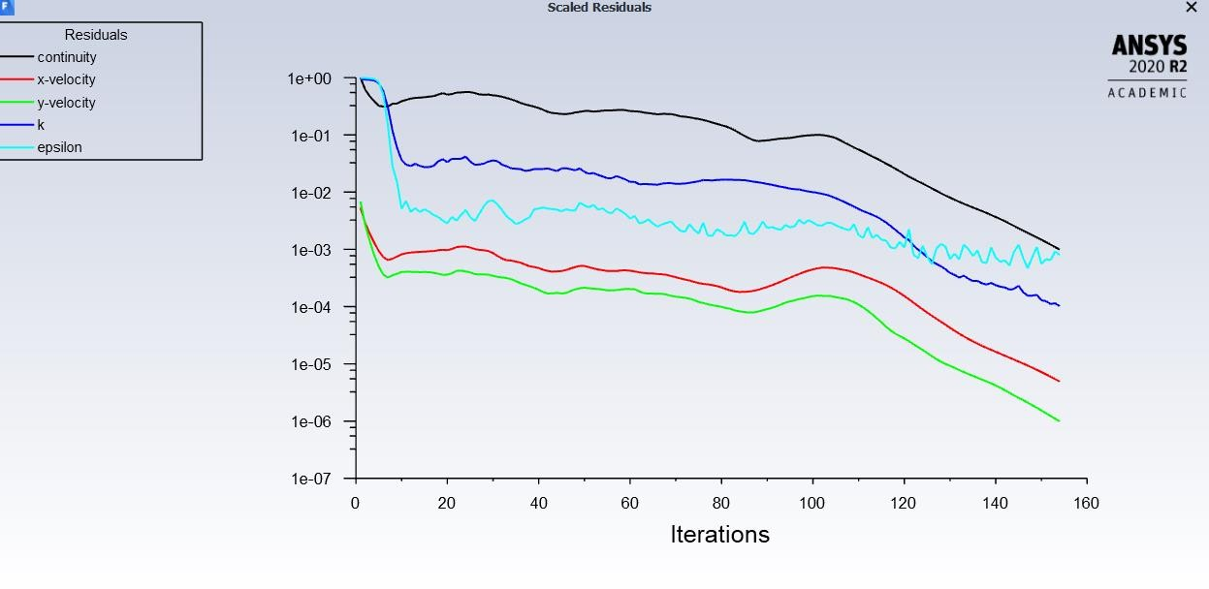
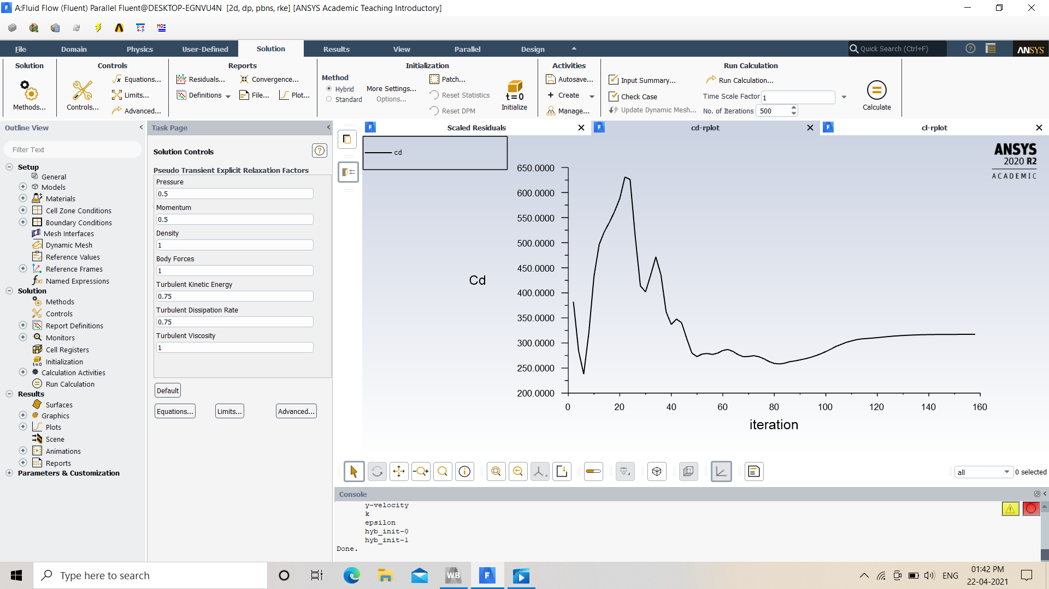
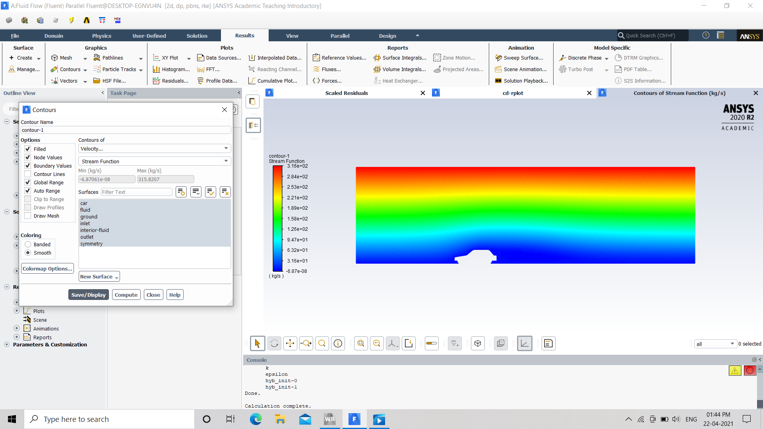
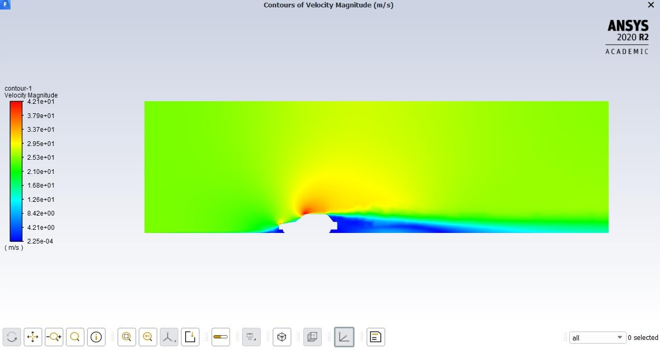
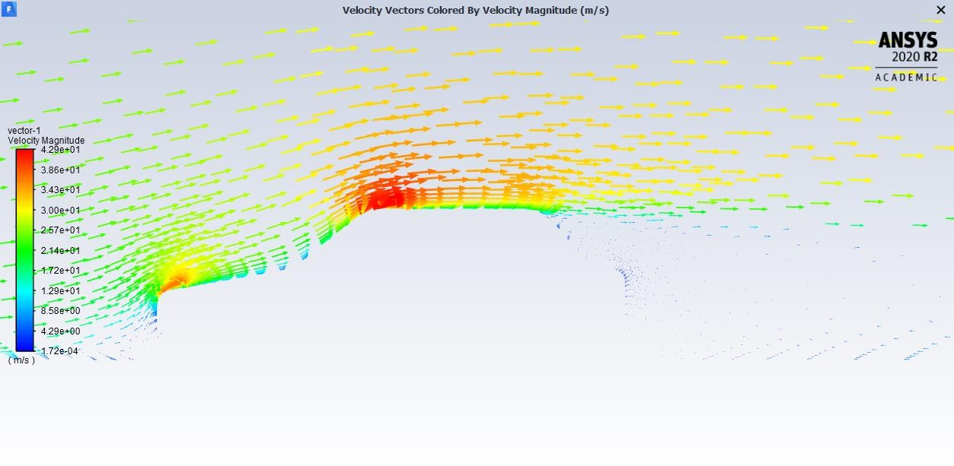
Fluid Mechanics
Project based Learning
Topic : CAR CROSS-SECTION
Introduction
Results
Automobiles on the roads today have various shapes and sizes, like sedans,
hatchbacks, pick-up trucks, SUVs, sports cars and more. Each car model is
optimized for a specific operation; for example, a sports car is designed to optimize
the lift and drag forces acting on the car so that it can reach top speeds over a short
duration and enhance maneuvering capabilities at high speeds.
Aerodynamic Forces
Thrust - which assists with pushing an object ahead.
Drag - which keeps it down.
Lift - which keeps it airborne.
Modelling in Solidworks
Car model designing
Objective
Results
In this simulation, you will learn how to set up a simulation to analyze the flow over a 2D sedan cross section and to calculate various forces acting on the car. By using “ANSYS FLUENT.”
Graph of Drag
Physics set up
Results
Steps involved in Physics Setup:
1. Use steady state pressure based solver and select all the options.
2.Set viscous model. Use realizable k-epsilon model with enhanced wall treatment and click ok.
3.Set material properties. Use constant density.
4.Define boundary conditions. Set inlet as Velocity- Inlet with Velocity Magnitude of 25 m/s.
Set outlet as Pressure-Outlet and symmetry as Symmetry.
Contours of stream function Contours of velocity magnitude
Numerical solution
Results
Set solution methods and controls. Use defaults.
2.Set residuals criteria to 1e-3.
3.Define monitors for drag and lift coefficients.
4.Initialize and fill no. of iterations 500 and run the simulation
Results
Velocity vectors
Team Members :
Siddharth Yadav 2. Fakidul Azam
3. Jogesh Bhardwaj 4. Shahbaz Khan
5. Shahzeb Anwar
Instructor : MR. Faisal

